Slide 1
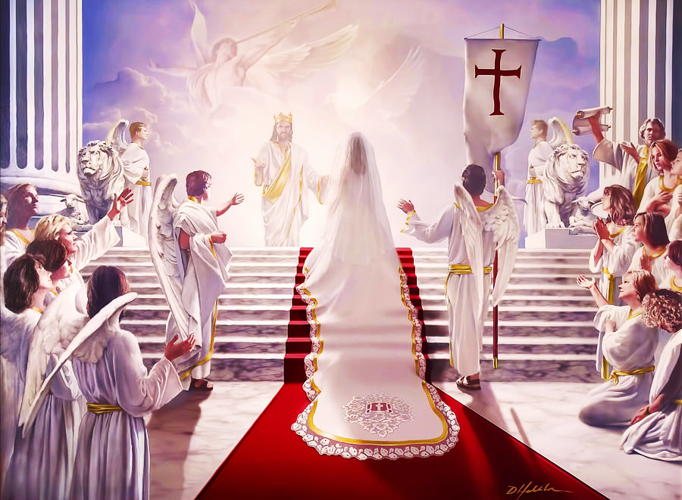
Best Wedding Ever!
The Marriage of the Lamb
Pt. 3 – The Bride Reflects the Groom

Slide 2
Note: After you download the slideshow, you may also need to download some videos from YouTube & add them into this PowerPoint. This tool can help you: Free YouTube Download
We present these messages in outdoor venues using the SonShineTent. Watch the video of our service that goes with this message, click here: http://campaignkerusso.org/?p=14783
We would love to know more about the people who download our lessons & sermons. We invite you to email us & let us know where & how you use them.
info@campaignkerusso.org

Slide 3
Welcome All

Slide 4
Let’s Begin with Prayer

Slide 5
Best Wedding Ever!
The Marriage of the Lamb
Pt. 3 – The Bride Reflects the Groom

Slide 6
Song: Oh, The Wedding of the Lamb
Video Goes Here Title: Oh, The Wedding of the Lamb Download Here:
https://youtu.be/otEgXJRTLSg

Slide 7
The Ceremony:
From where does
the bride come?

Slide 8
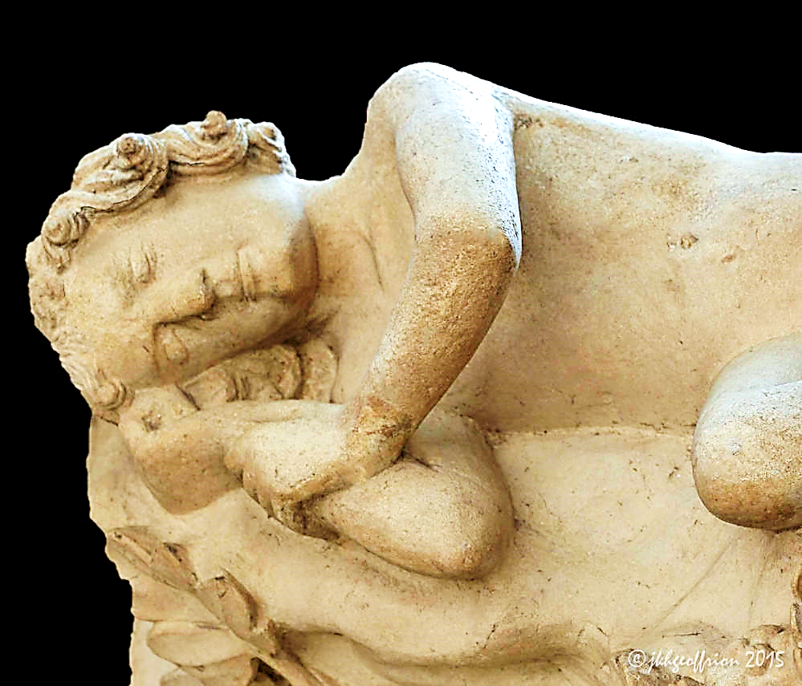
While Adam slept, through a wound in his side, his bride was created.

Slide 9
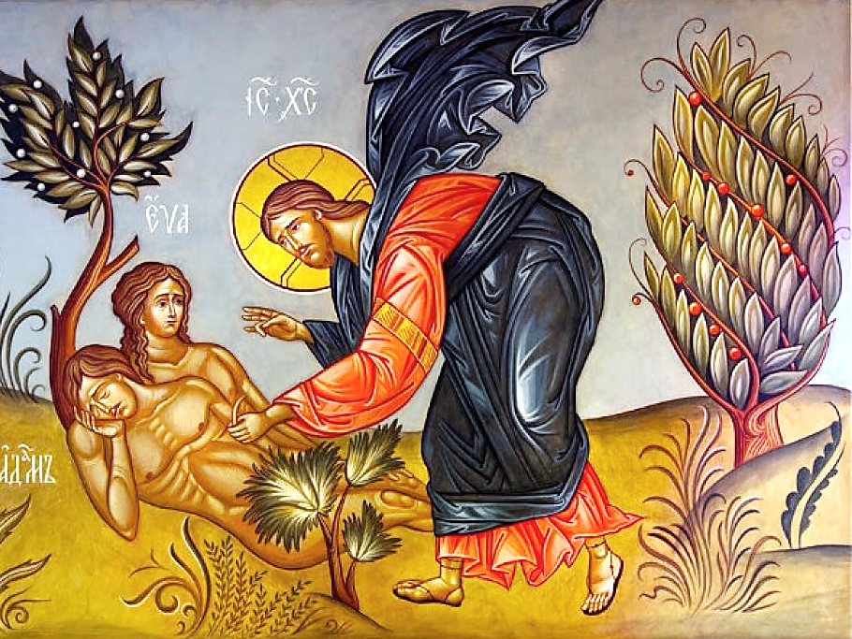
“He formed a woman out of the rib and brought her to him.” Gen. 2:22 GNT

Slide 10
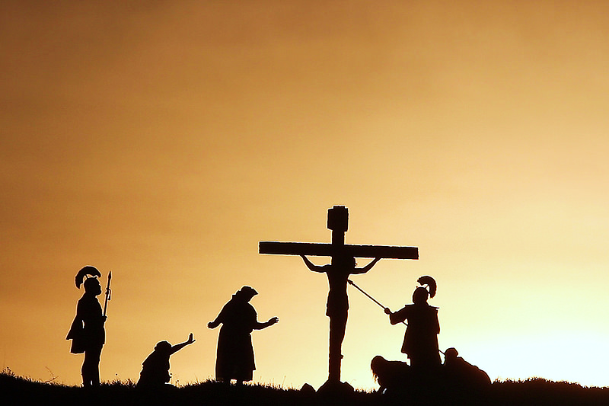
When Jesus died, His side was also wounded and His bride was created through His death.
“But one of the soldiers pushed a spear into His side. Blood and water ran out.”
Jn. 19:34 NLV

Slide 11
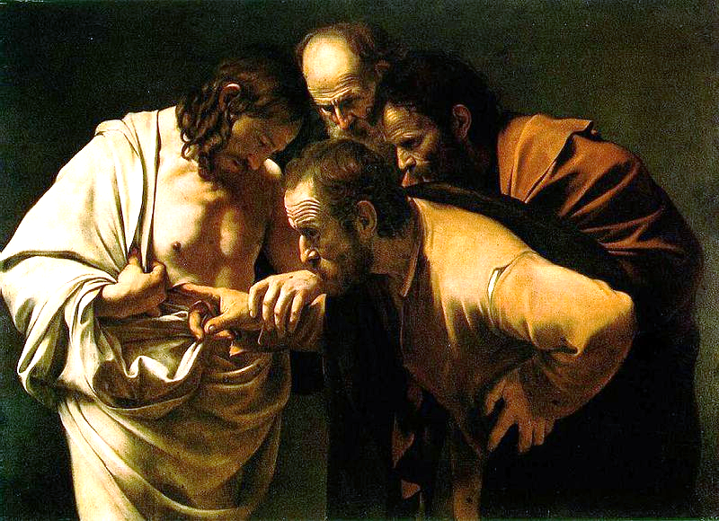
“He showed them his hands and side. And how wonderful was their joy as they saw their Lord!” Jn. 20:20 TLB

Slide 12
Adam Became One with His Bride
“This explains why a man leaves his father and mother and is joined to his wife in such a way that the two become one person.” Gen 2:24 TLB

Slide 13
“We are parts of his body. That’s why a man will leave his father and mother and be united with his wife, and the two will be one.
This is a great mystery. (I’m talking about Christ’s relationship to the church.)”
Eph. 5:30-32 GW
Jesus and His Bride Are One

Slide 14
“Surely you know that your bodies are parts of Christ himself…” 1 Cor. 6:15 NCV
“But the one who joins with the Lord is one spirit with the Lord.” Cor. 6:17 NCV

Slide 15
The Bride Reflects the Groom
(Made in
His Image)
“This is it!” Adam exclaimed. “She is part of my own bone and flesh! Her name is ‘woman’ because she was taken out of a man. Gen 2:23 TLB

Slide 16
Jesus made His bride in His image and one day she will reflect Him in every way.
“[We]…show the bright glory of the Lord, as the Lord’s Spirit makes us more and more like our glorious Lord.” 2 Cor. 3:18 CEV
“He will make these poor bodies of ours like his own glorious body.” Phil. 3:21 CEV

Slide 17
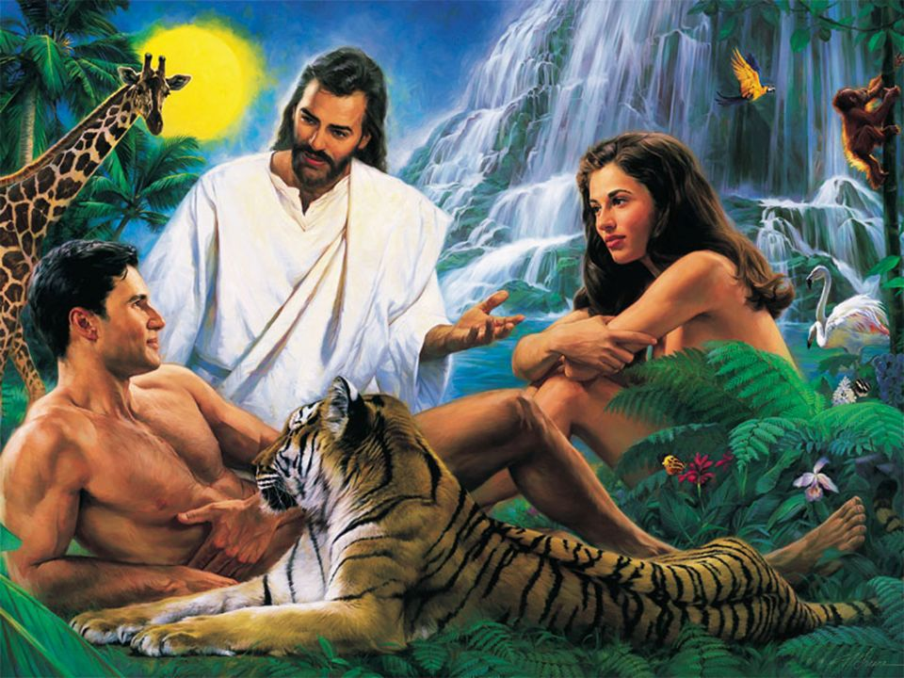
The Ceremony:
Who gives this bride away?
“Then the LORD God made a woman from the rib he had taken out of the man, and he brought her to the man.” Gen. 2:22

Slide 18
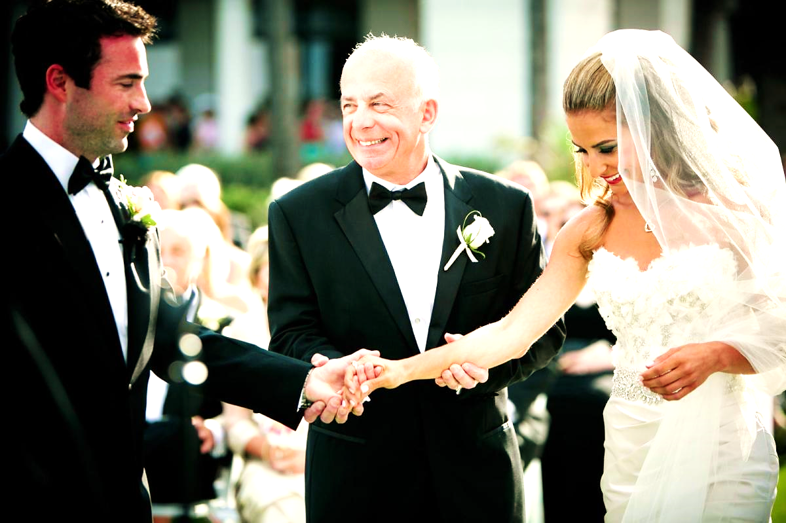
Just as the Lord gave the bride to Adam, fathers today give the bride to the groom.

Slide 19
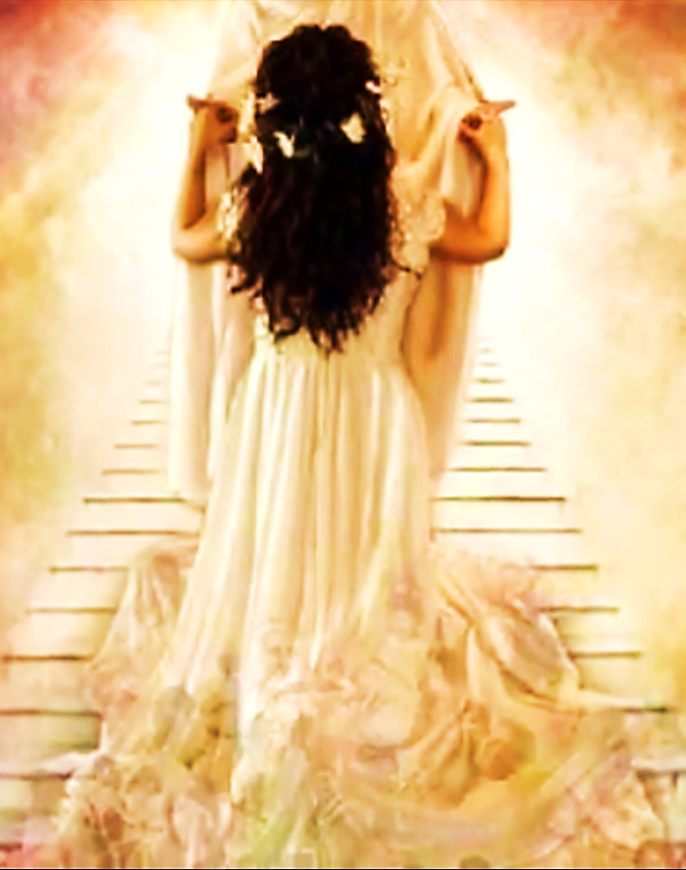
“…Christ loved the church and gave himself up for her…having cleansed her by the washing of water with the word, that he might present the church to himself in splendor, without spot or wrinkle or any such thing, that she might be holy and without blemish.” Eph. 5:25, 27 RSV
BUT, Since Jesus is God (and there is none higher), He actually presents His bride to Himself.

Slide 20
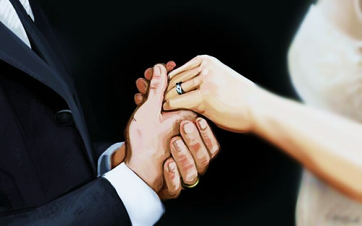
The Groom pays a price to join his bride—he must forsake all others.
“For this cause a man will leave his father and mother and will be joined to his wife. The two will become one flesh.” Eph. 5:31 WEB

Slide 21
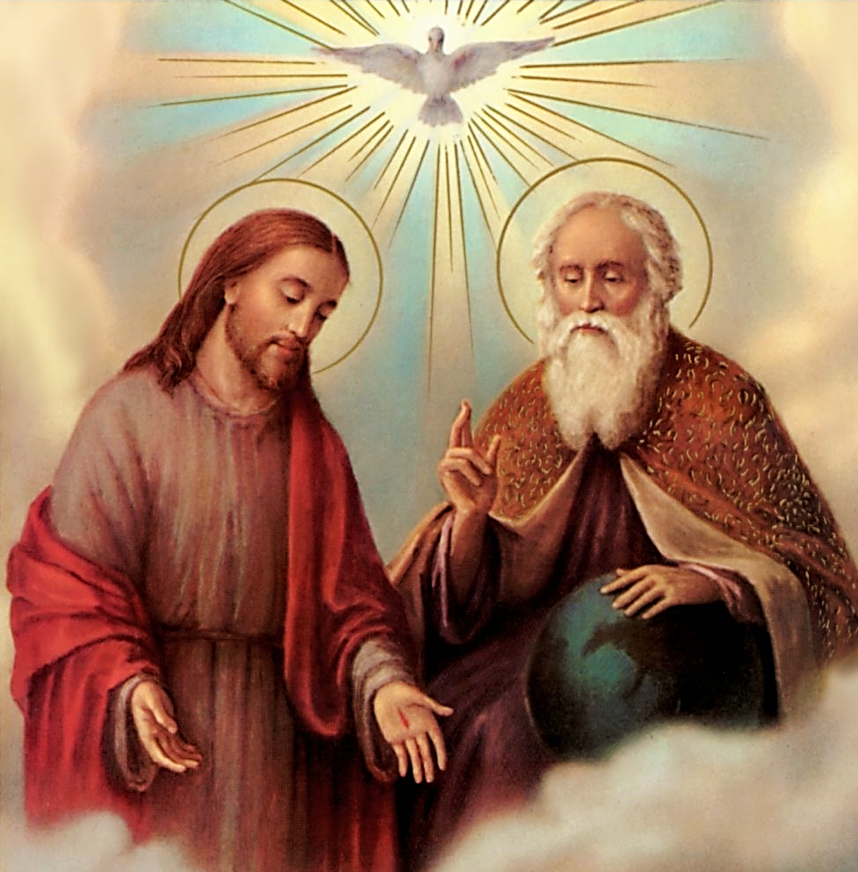
Likewise, Jesus left all for the cause of humanity:
“I came from the Father into the world...”
Jn. 16:28 CEV

Slide 22
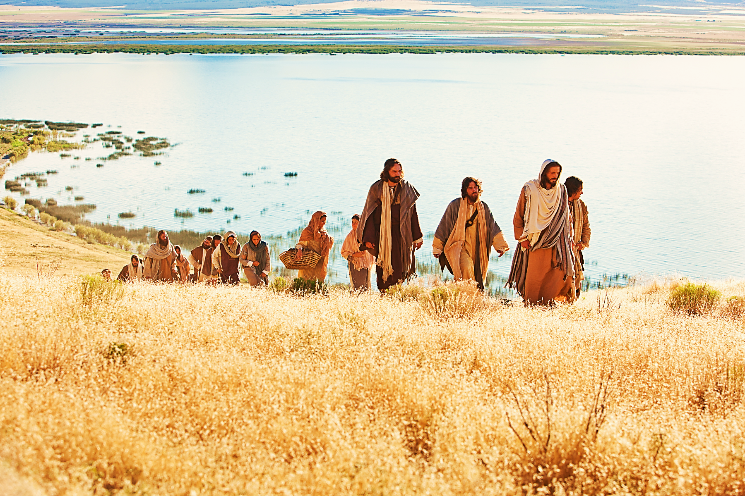
Now, He Asks Us to
Leave All for His Cause
Jesus said, ‘Truly, I say to you, there is no one who has left house or brothers…
…or sisters or mother or father or children or lands, for my sake and for the gospel, who will not receive a hundredfold… and in the age to come, eternal life.’” Mat. 19:29, 30 ESV
What are we willing to
leave for His cause?

Slide 23
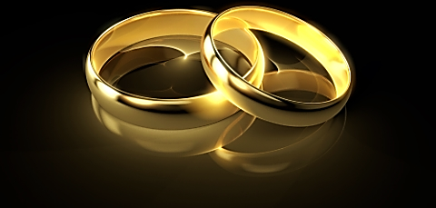
Consider the following questions:
From where did Adam’s & Jesus’ brides come?
How are Adam’s & Jesus’ brides made in the images of their grooms?
In the case of Adam’s & Jesus’ weddings, who gives the brides away?
What did Jesus do for His bride and what must she do for her groom’s cause?

Slide 24
Song: The Cause of Christ
Video Goes Here Title: The Cause of Christ Download Here:
https://youtu.be/v0ybgYajDHg

Slide 25
Note: After you download the slideshow, you may also need to download some videos from YouTube & add them into this PowerPoint. This tool can help you: Free YouTube Download
We present these messages in outdoor venues using the SonShineTent. Watch the video of our service that goes with this message, click here: http://campaignkerusso.org/?p=14783
We would love to know more about the people who download our lessons & sermons. We invite you to email us & let us know where & how you use them.
info@campaignkerusso.org

Slide 26
Is Jesus
Speaking to You?
“They said to each other, ‘Did not our hearts burn within us while he talked to us on the road, while he opened to us the Scriptures?’”
John Wesley Said:
“…the preacher was describing the change which God works in the heart through faith in Christ and I felt my heart strangely warmed.”
Jesus makes His presence Known by a small voice!

Slide 28
What is the Sinner‘s Prayer?
This is a prayer we can pray when we are ready to admit we are sinners and need Christ’s forgiveness.
It must be prayed with faith in our hearts and a readiness to have a life-changing encounter with Jesus Christ.

Slide 29
A prayer of faith → Pray this prayer if :
If you never have before
You have in the past, but you think it would mean more today
You have been walking afar off and you want to come back
You want to set an example & show others how it is done
You just like to give your heart to Jesus again & again
Faith

Slide 30
We Declare Our Faith Publicly Because Jesus Declared His LOVE Publicly
“If you stand before others and are willing to say you believe in me, then I will tell my Father in heaven that you belong to me.” Mat 10:32

Slide 31
Three Important Questions
Do you want to know Jesus as your Savior right now?
Do you believe He died to save you from your sins & that He rose from the dead?
Do you believe that He is here, waiting to save you right now?

Slide 32
The Prayer of a Sinner Turning to Jesus
Dear Jesus, I know that I have sinned against You and that my sins separate me from You.
I am truly sorry.
Right now, I turn away from my sinful past .
Please forgive me, and help me to keep from sin.
I believe You died for my sins.
I Believe You rose from the dead, you are alive, and you hear this prayer from my heart.
I invite You Jesus to be both my Savior and the Lord of my life.
I want You to rule my life from now on.

Slide 33
“But some people did accept him. They believed in him, and he gave them the right to become children of God.”
John 1:12

Slide 35
“If you openly say, ‘Jesus is Lord’ and believe in your heart that God raised him from death, you will be saved.”
Rom. 10:9
What did you learn today?
What are the Bride & Groom willing to do for each other?
What have you been thinking about God lately?
What do you want to tell others about Jesus?

Slide 36
Let’s Close in Prayer

Slide 37
Note: After you download the slideshow, you may also need to download some videos from YouTube & add them into this PowerPoint. This tool can help you: Free YouTube Download
We present these messages in outdoor venues using the SonShineTent. Watch the video of our service that goes with this message, click here: http://campaignkerusso.org/?p=14783
We would love to know more about the people who download our lessons & sermons. We invite you to email us & let us know where & how you use them.
info@campaignkerusso.org

